Slide 1
Learning Parts of Speech
By:
Liz Mnatzaganian and
Shannon Richardson

Slide 2
Noun
A person, place, or thing
Notes:
Click in the space to go to slide 3.

Slide 3
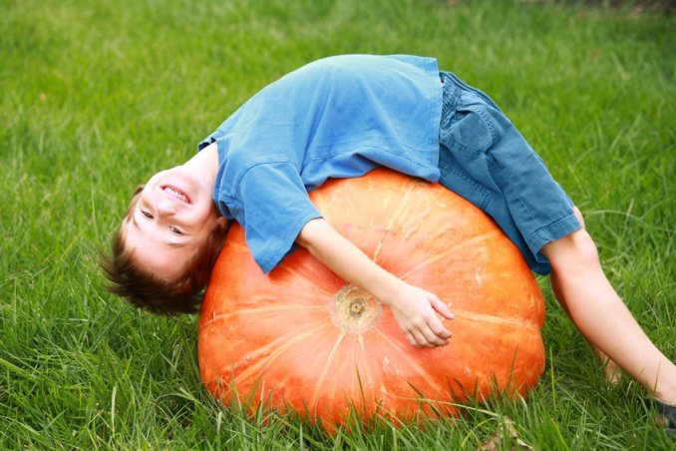
Boy; pumpkin
Tree; sky
Girl; laptop; grass; building
Dog; glasses, book

Slide 4
Adjective
Describes a noun
Answers a question:
What kind?
How many?
Which one?
Notes:
Click on the side to go to slide 5.

Slide 5
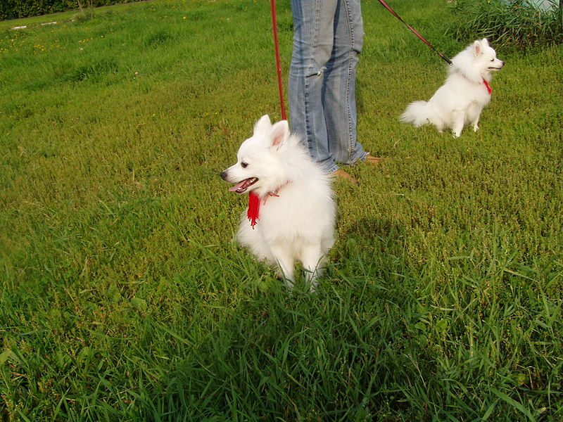
What kind of dog?
Brown, spotted, big, little, furry, friendly, cuddly, scary…
How many dogs?
One, two, three, twelve, one-hundred, a lot, not many, a few…
Which one?
My, his, yours, ours…

Slide 6
Verb
Action; it’s what the noun is doing
Notes:
Click on the side to go to slide 7.

Slide 7
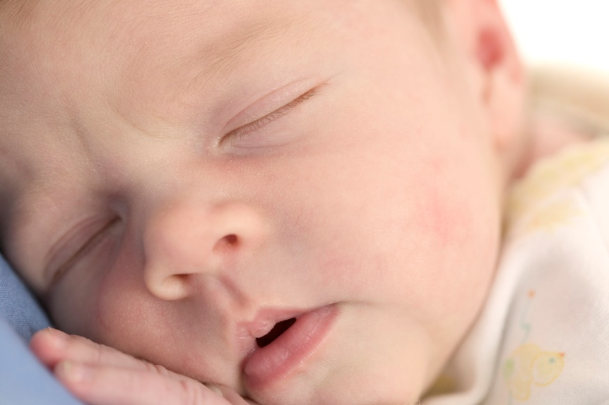
Sleeping
Painting
Swimming
Jumping

Slide 8
Adverb
Describes a verb
Answers the questions:
How?
When?
Where?
Notes:
Click on the side to go to slide 9.

Slide 9
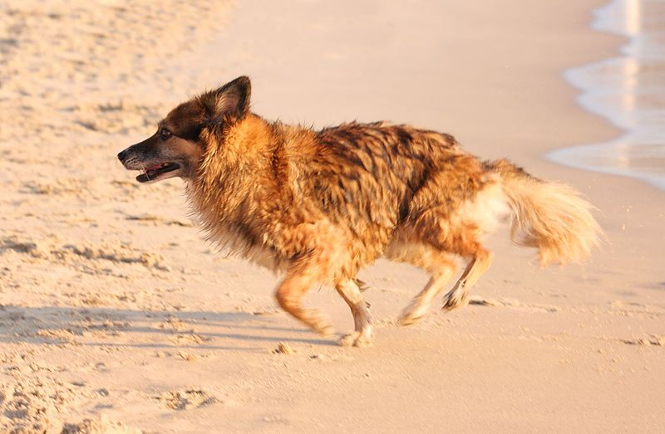
How?
Fast, slowly, high, quickly, loudly, quietly, softly, hungrily…
When?
Today, yesterday, tomorrow, next week, now…
Where?
Far, near, close, behind,
in front, inside, outside

Slide 10
Pronoun
Replaces a Noun
Tells Who
Notes:
Click on the side to go to slide 11.

Slide 11
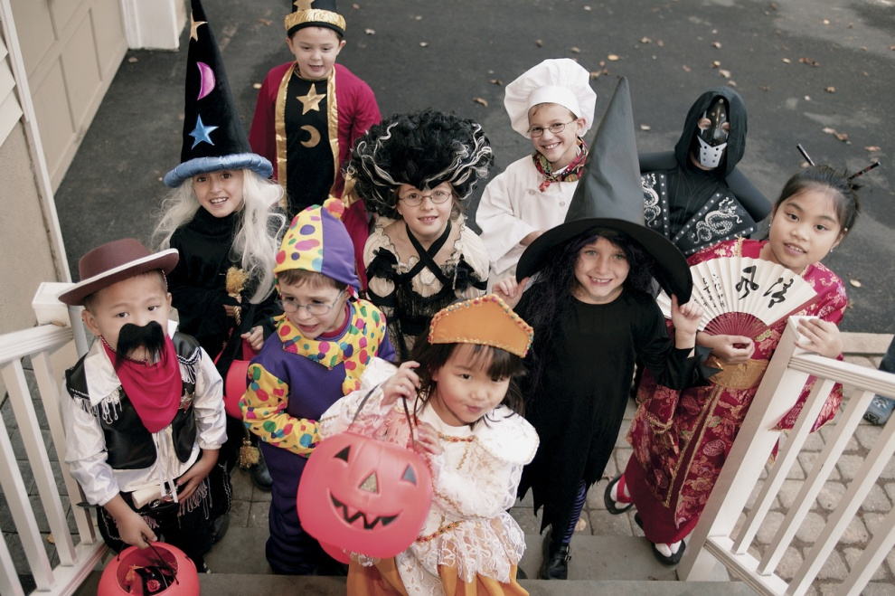
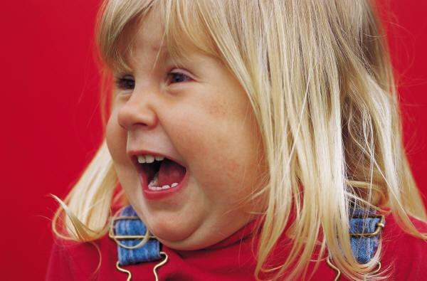
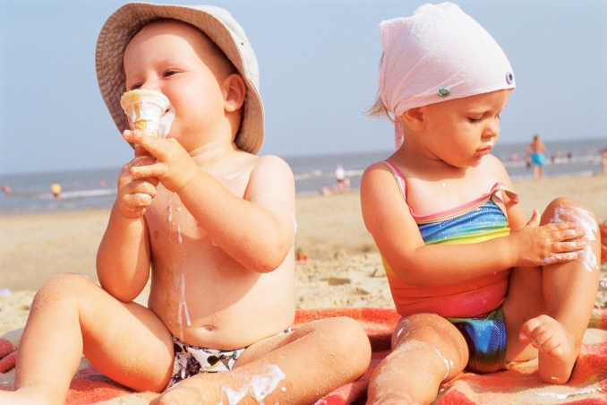
Pronouns:
He, she, they, we, you, I, them, us, it

Slide 12
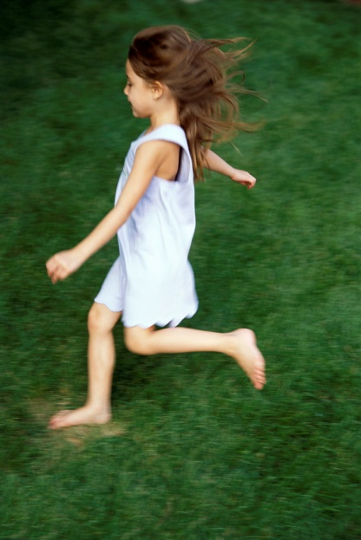
The
tall
boy
jumped
high.
She
ran
quickly
in the
green
grass.
Notes:
Click each word in the sentence to go to the parts of speech. After seeing that part of speech, click on the hyperlink to come back to this page.

Slide 13
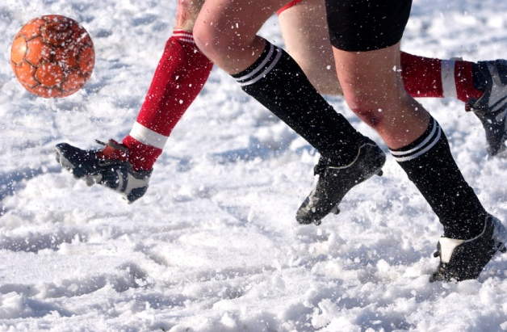
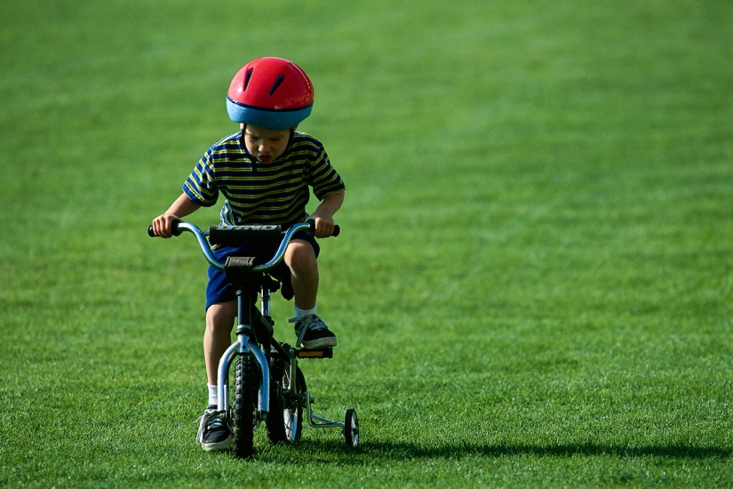
Make a sentence about each picture you see

Slide 14
Explain these parts of speech What do they do?
Noun
Adjective
Verb
Pronoun
Adverb
Notes:
Click on each part of speech. After clicking each part of speech, this is the end of the slideshow.

Slide 15
Noun
A person, place, or thing
Notes:
Click on the hyperlink

Slide 16
Adjective
Describes a noun
Answers a question:
What kind?
How many?
Which one?
Notes:
Click on the hyperlink

Slide 17
Verb
Action; it’s what the noun is doing
Notes:
Click on the hyperlink

Slide 18
Adverb
Describes a verb
Answers the questions:
How?
When?
Where?
Notes:
Click on the hyperlink

Slide 19
Pronoun
Replaces a Noun
Tells Who
Notes:
Click on the hyperlink

